Slide 1
Revenue Forecast Analysis, CarMax

Slide 2
Problem

Slide 3
Approach
Modeling
Linear Model
ARIMA Model
Testing/Analysis
Mean Percentage Error

Slide 4
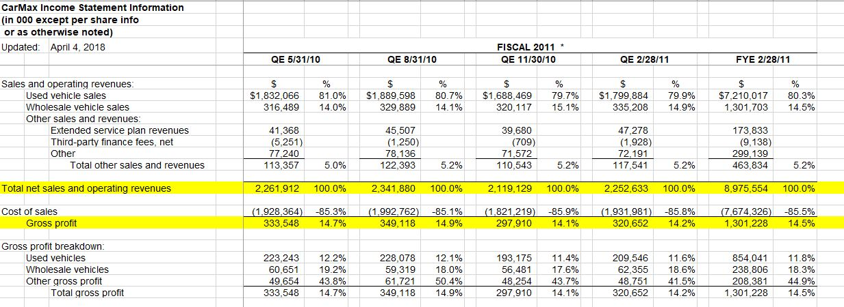
Data

Slide 5
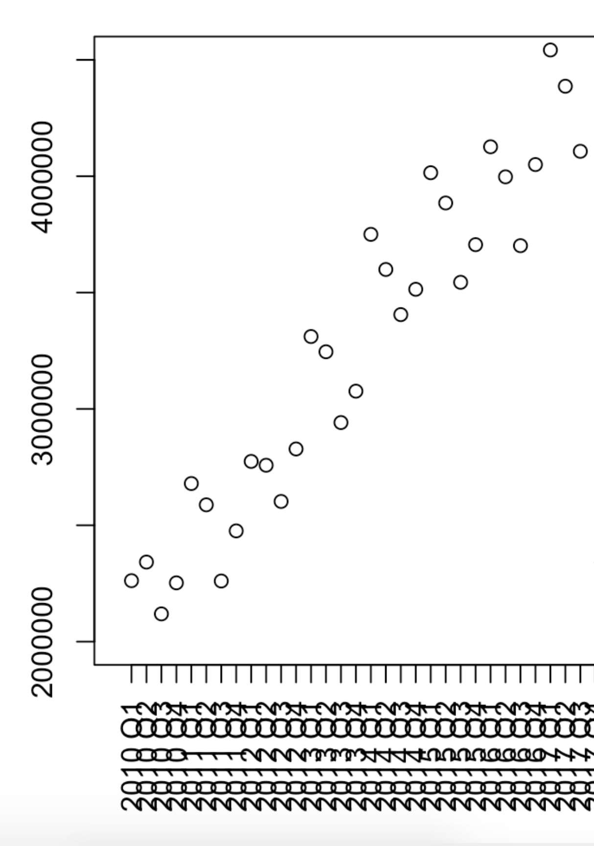

Slide 6
Results
Revenue Forecasting
Profit Forecasting
Revenue based on New Stores

Slide 7
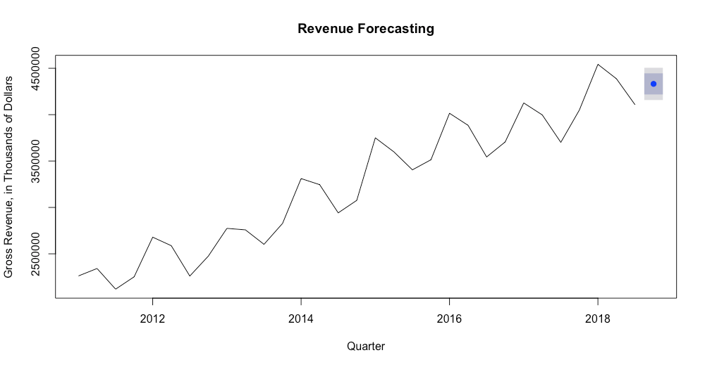
2018 Q4 Forecasted: $4,331,547,000 (4.33 Billion)
2018 Q4 Actual: $4,084,218,000 (4.08 Billion)
MPE: 0.1316

Slide 8
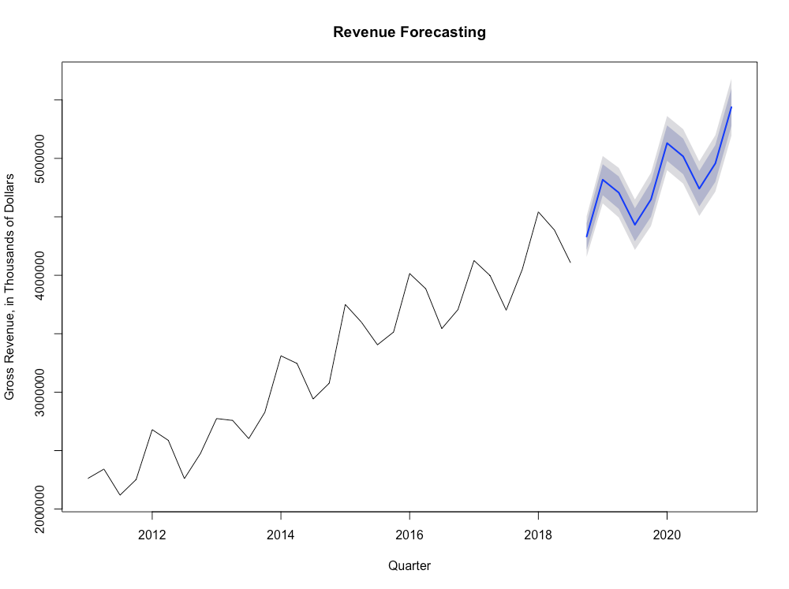

Slide 9
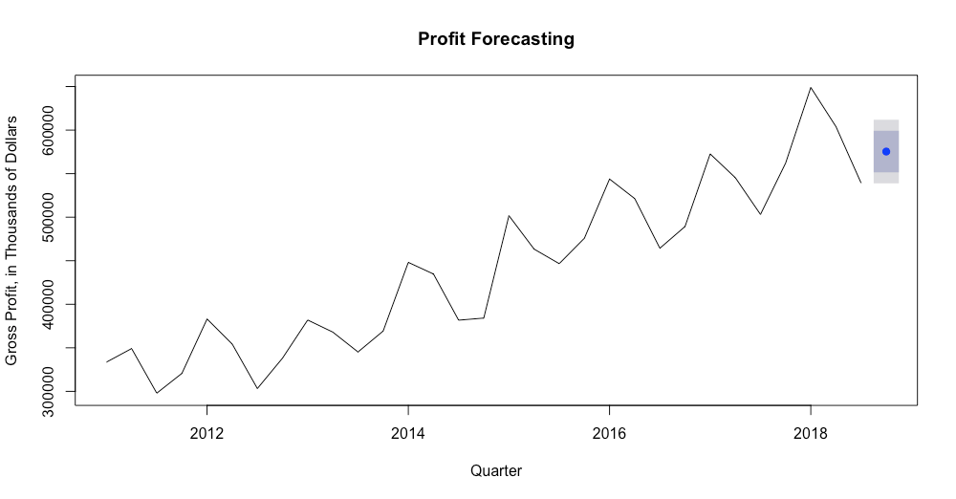
2018 Q4 Forecasted: $575,369,000 (575 Million)
2018 Q4 Actual: $536,728,000 (536 Million)
MPE: 0.5386

Slide 10
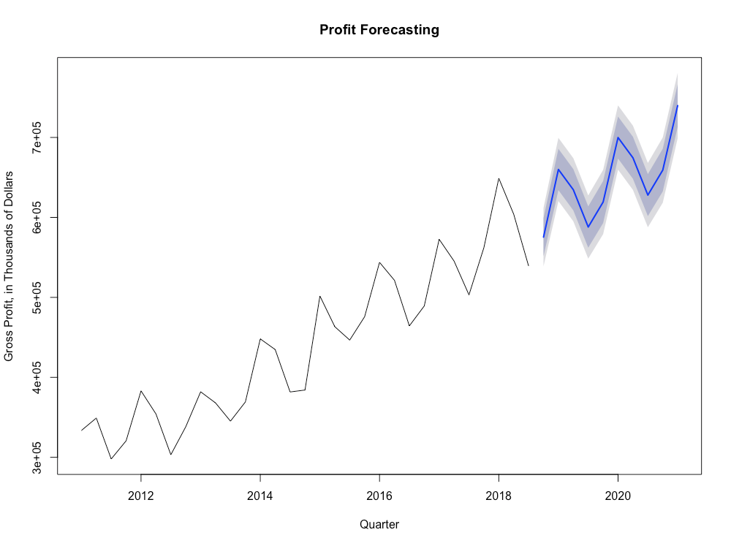

Slide 11
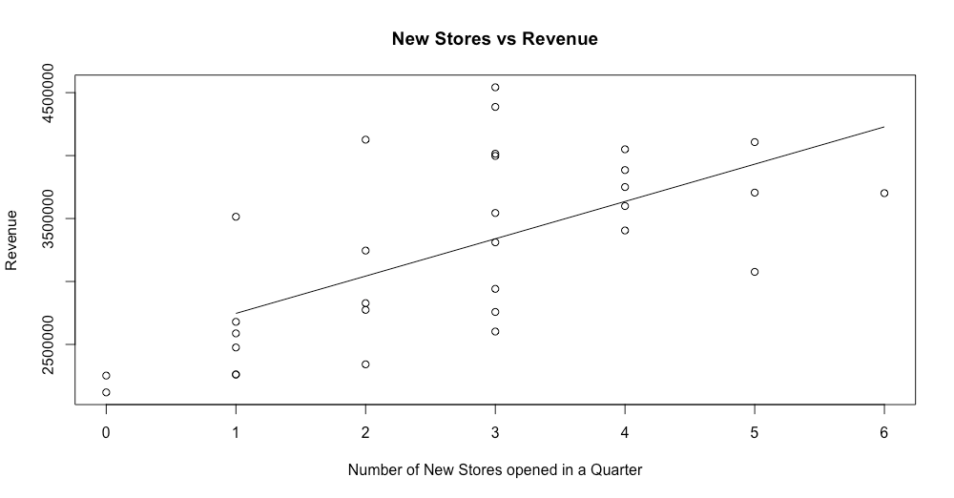
Multiple R-Squared: 0.406 Adjusted R-Squared: 0.3855

Slide 12
Questions?

